Slide 1
UMM Data Services Center

Slide 2
What is the Data Services Center?
2 Aspects
Online Resource
Community User
Search pre-determined reports
View charts, graphs, data
Interact with CST Staff
Interpretation Center
Advanced User
Search
Create
Analyze
Communicate
Publish
Data Consultation Service
Data Gathering
Analysis
Reporting
Interpretation

Slide 3
Who’s Involved? – Center for Small Towns
Academic Community
Student Involvement
Program Evaluation
Applied Research and Information
Community Planning and Support
Symposium and Conversation Series
Rural Communities and Organizations

Slide 4
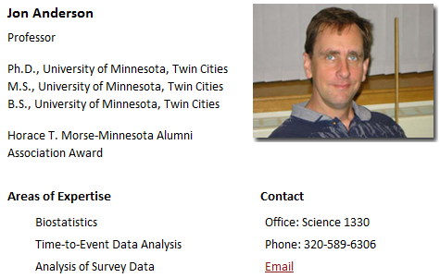
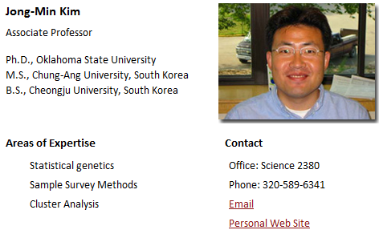
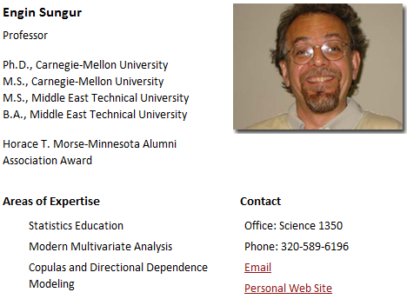
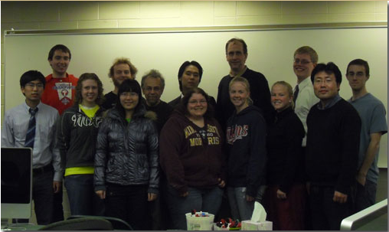
Who’s Involved? – Statistics Discipline

Slide 5
Who is the Data Services Center?
Data Services Center
Statistics Discipline and Academic Community

Slide 6
Technical Components
Data Services Center Project Data
User Submitted Data
Data Services Center Database
Other Gov’t Agencies, Orgs Data
Partner Database

Slide 7
Academic Connection
Academics
Student & Faculty Research
Community Service Projects
Classroom Incorporation
Faculty & Student Relationships

Slide 8
Why the Partner Database?
Resources
Staff
Financial
Skills
Infrastructure

Slide 9
Questions and Discussion
Is the conceptual framing for the Data Service Center hitting the target for community value?
How about for researchers and advanced users?

Slide 10
Questions and Discussion
Is the data resource that we are seeking something that MN Compass can provide?
Do you see value in the Center for Small Towns partnerships offering?

